Slide 1
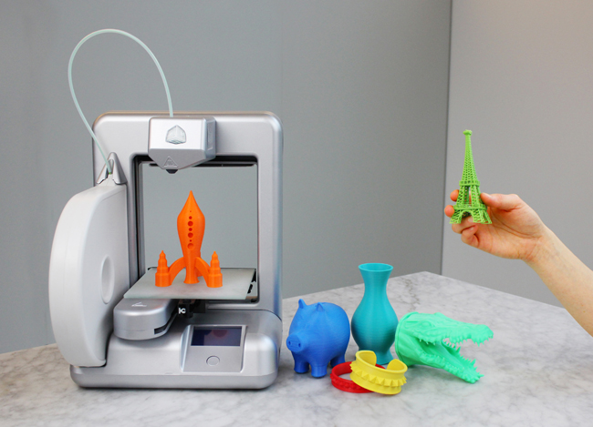
Image from theregister.co.uk

Slide 2
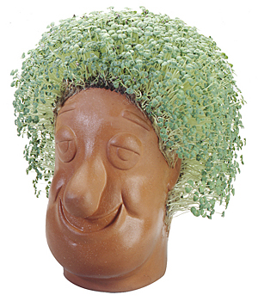
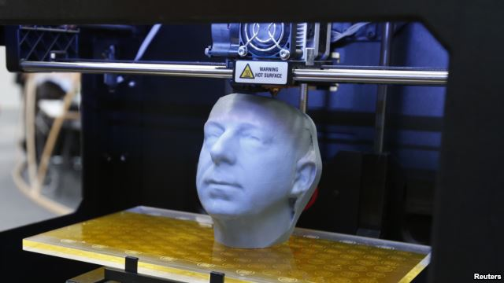
Image from chiapet.com
Image from rferl.org

Slide 3
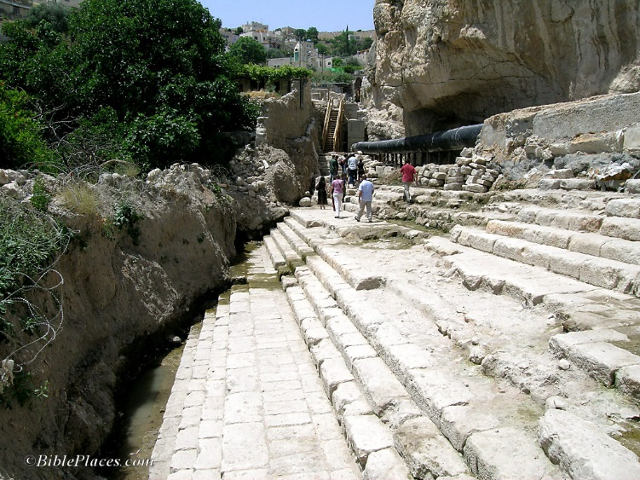
John 7.37-52

Slide 4
John 7.37-39 NET: On the last day of the feast, the greatest day, Jesus stood up and shouted out, “If anyone is thirsty, let him come to me, and ³⁸let the one who believes in me drink. Just as the scripture says, ‘From within him will flow rivers of living water.’” ³⁹(Now he said this about the Spirit, whom those who believed in him were going to receive, for the Spirit had not yet been given, because Jesus was not yet glorified.)
John 7.37-52
Image from biblicalstudies.info

Slide 5
John 7.37: On the last day of the feast, the greatest day, Jesus stood up and shouted out, “If anyone is thirsty, let him come to me…
The New Covenant:
 Sanctifying cleansing of believers
 Intimacy with God for believers
 Forgiveness for believers
 Indwelling Holy Spirit to empower believers
John 7.37-52
Image from biblicalstudies.info

Slide 6
John 7.37-39: On the last day of the feast, the greatest day, Jesus stood up and shouted out, “If anyone is thirsty, let him come to me, and ³⁸let the one who believes in me drink. Just as the scripture says, ‘From within him will flow rivers of living water.’” ³⁹(Now he said this about the Spirit, whom those who believed in him were going to receive, for the Spirit had not yet been given, because Jesus was not yet glorified.)
John 7.37-52
Image from biblicalstudies.info

Slide 7
John 7.40-43: When they heard these words, some of the crowd began to say, “This really is the Prophet!” ⁴¹Others said, “This is the Christ!” But still others said, “No, for the Christ doesn't come from Galilee, does he? ⁴²Don't the scriptures say that the Christ is a descendant of David and comes from Bethlehem, the village where David lived?” ⁴³So there was a division in the crowd because of Jesus. ⁴⁴Some of them were wanting to seize him, but no one laid a hand on him.
John 7.37-52
Image from biblicalstudies.info

Slide 8
John 7.40-43: When they heard these words, some of the crowd began to say, “This really is the Prophet!” ⁴¹Others said, “This is the Christ!” But still others said, “No, for the Christ doesn't come from Galilee, does he? ⁴²Don't the scriptures say that the Christ is a descendant of David and comes from Bethlehem, the village where David lived?” ⁴³So there was a division in the crowd because of Jesus. ⁴⁴Some of them were wanting to seize him, but no one laid a hand on him.
John 7.37-52
Image from biblicalstudies.info

Slide 9
John 7.45-49: Then the officers returned to the chief priests and Pharisees, who said to them, “Why didn't you bring him back with you?” ⁴⁶The officers replied, “No one ever spoke like this man!” ⁴⁷Then the Pharisees answered, “You haven't been deceived too, have you? ⁴⁸None of the rulers or the Pharisees have believed in him, have they? ⁴⁹But this rabble who do not know the law are accursed!”
John 7.37-52
Image from biblicalstudies.info

Slide 10
John 7.50-52: Nicodemus, who had gone to Jesus before and who was one of the rulers, said, ⁵¹“Our law doesn't condemn a man unless it first hears from him and learns what he is doing, does it?” ⁵²They replied, “You aren't from Galilee too, are you? Investigate carefully and you will see that no prophet comes from Galilee!”
John 7.37-52
Image from biblicalstudies.info

Slide 11
Jesus is…
 The Greater Moses Prophet
 The Christ / Messiah
 The Ultimate Davidic King
 Son of Man from Daniel’s prophecy
John 7.37-52
Image from biblicalstudies.info

Slide 12
Jesus…
died to bring the New Covenant and pay our penalty for sin
was resurrected to prove his victory and assure us of our own deliverance
ascended to be our mediator guaranteeing our salvation and to send the Holy Spirit
John 7.37-52
Image from biblicalstudies.info

Slide 13
As part of our salvation…
the Holy Spirit brings us to faith and regenerates us
God declares us righteous in his sight, attributing to us the righteousness of Christ
The Holy Spirit begins sanctifying us
The Holy Spirit indwells us and empowers us
John 7.37-52
Image from biblicalstudies.info

Slide 14
John 7.37-52
Image from biblicalstudies.info

